Slide 1
Structural Competency: A Positive Framework for Addressing the Social Determinants of Health
Ryan Huerto, MD, MPH, MA PRIME Statewide Conference, 1/25/2020

Slide 2
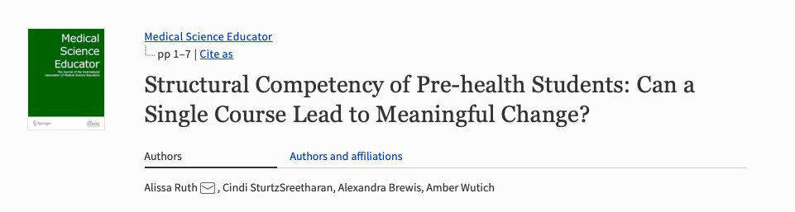
Study out of ASU shows that structural competency curriculum increases pre-health students' "ability to identify structural factors and articulate them with deeper understandings."

Slide 3
Objectives
Describe the need for structural competency and structural interventions
Give examples of structural competency in the clinic and community
Describe concrete steps for increasing structural competency
Apply structural competency to clinical cases

Slide 4
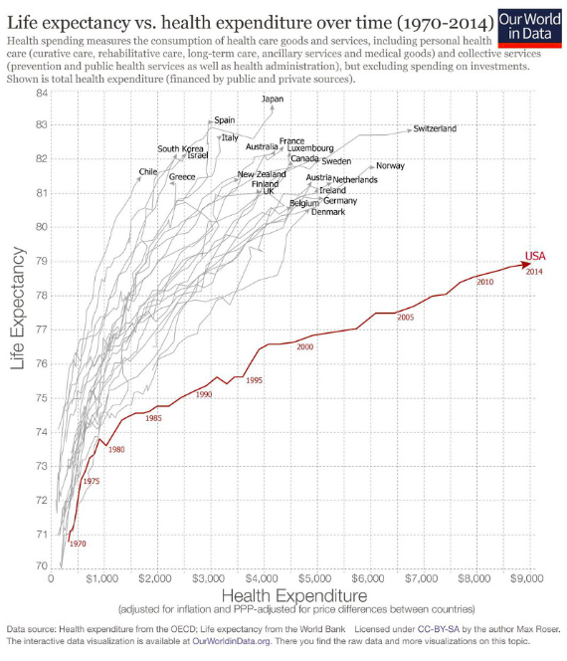

Slide 5
Major Contributors to U.S. Morbidity and Mortality
Poor birth outcomes
Injuries and homicides
Heart disease
Diabetes
Chronic lung disease
Disability
Adolescent pregnancy
HIV and AIDS
Drug-related death

Slide 6
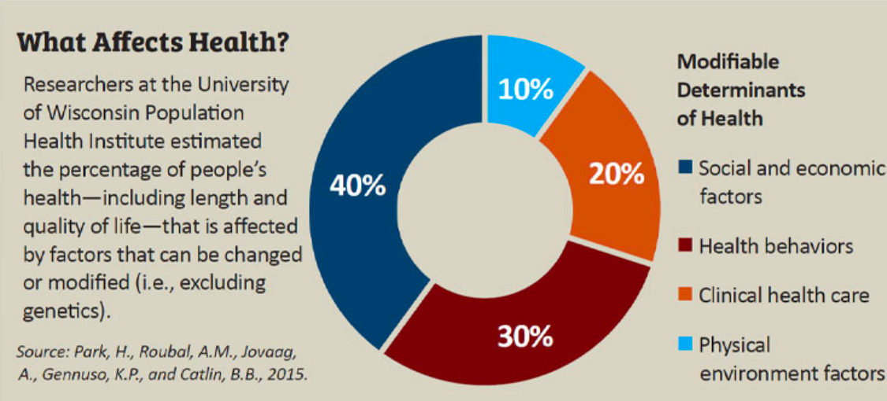

Slide 8
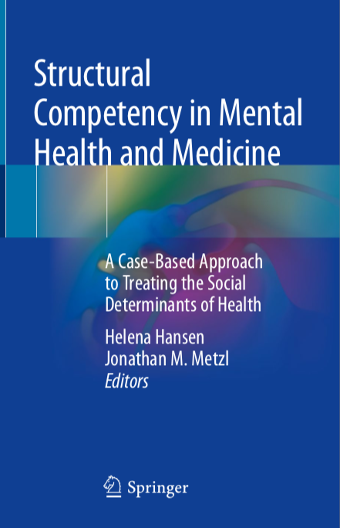

Slide 9
“The growing movement for ‘structural competency’ radically departs from these biological and cultural approaches by contending that ‘many health-related factors previously attributed to culture or ethnicity also represent the downstream consequences of decisions about larger structural contexts, including healthcare and food delivery systems, zoning laws, local politics, urban and rural infrastructures, structural racisms, or even the very definitions of illness and health.’ Healthcare providers need to be more competent at recognizing and addressing the upstream structural factors that determine patients’ health and create health inequities.

Slide 10
“The growing movement for ‘structural competency’ radically departs from these biological and cultural approaches by contending that ‘many health-related factors previously attributed to culture or ethnicity also represent the downstream consequences of decisions about larger structural contexts, including healthcare and food delivery systems, zoning laws, local politics, urban and rural infrastructures, structural racisms, or even the very definitions of illness and health.’ Healthcare providers need to be more competent at recognizing and addressing the upstream structural factors that determine patients’ health and create health inequities.
Structural competency is revolutionary. It not only addresses the negative impact of structural inequalities of health but forges a path to undo medicine’s support for an unjust social order.”
- Dorothy E. Roberts, JD

Slide 11
Dr. Mona Hanna-Attisha and Flint Water Crisis
Notes:
https://www.youtube.com/watch?v=1I2DvG_ocHg

Slide 12
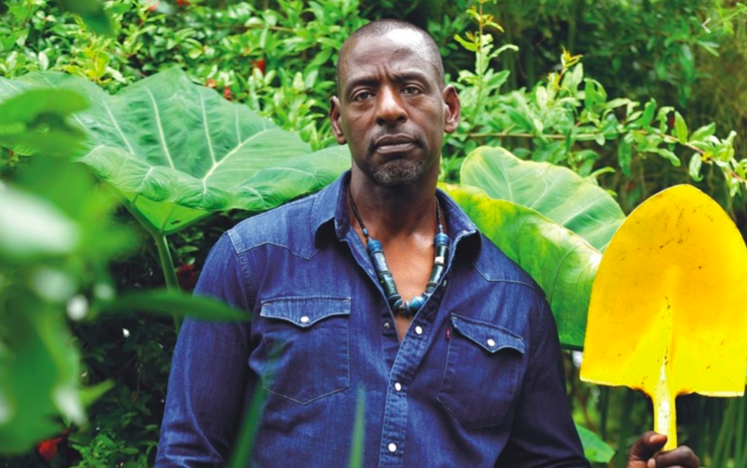
Ron Finley “The Gangster Gardener”
Notes:
https://www.youtube.com/watch?v=7t-NbF77ceM

Slide 13
Concrete ways to increase structural competency
“Be skeptical of race-based differences in diagnosis.”

Slide 14
Concrete ways to increase structural competency
“Be skeptical of race-based differences in diagnosis.”
“Create alliances between doctors and other professionals who serve the same vulnerable patients.”

Slide 15
Concrete ways to increase structural competency
“Be skeptical of race-based differences in diagnosis.”
“Create alliances between doctors and other professionals who serve the same vulnerable patients.”
“Be creative in addressing extra-clinical structural problems.”

Slide 16
Concrete ways to increase structural competency
“Be skeptical of race-based differences in diagnosis.”
“Create alliances between doctors and other professionals who serve the same vulnerable patients.”
“Be creative in addressing extra-clinical structural problems.”
“Learn from social science and humanities disciplines such as sociology, anthropology, history, and critical race theory to be more aware of the ways racism is embedded in institutions and operates apart from the blatant acts of individual bias.”

Slide 17
Concrete ways to increase structural competency
“Be skeptical of race-based differences in diagnosis.”
“Create alliances between doctors and other professionals who serve the same vulnerable patients.”
“Be creative in addressing extra-clinical structural problems.”
“Learn from social science and humanities disciplines such as sociology, anthropology, history, and critical race theory to be more aware of the ways racism is embedded in institutions and operates apart from the blatant acts of individual bias.”
“Draw lessons from other professions that have taken active steps toward addressing structural racism.”

Slide 18
Concrete ways to increase structural competency
“Be skeptical of race-based differences in diagnosis.”
“Create alliances between doctors and other professionals who serve the same vulnerable patients.”
“Be creative in addressing extra-clinical structural problems.”
“Learn from social science and humanities disciplines such as sociology, anthropology, history, and critical race theory to be more aware of the ways racism is embedded in institutions and operates apart from the blatant acts of individual bias.”
“Draw lessons from other professions that have taken active steps toward addressing structural racism.”
“Speak up more vocally about structural issues that impact patients—politically.”

Slide 19
Case Studies
Please divide up into groups of 2 - 3 people and be prepared to summarize your group’s case:
Case 1: The Overdiagnosis of Schizophrenia
Case 2: The Unhealthy Diet
Case 3: The Punitive Treatment of Women Who Use Drugs During Pregnancy

Slide 20
Answer the following regarding your case:
What structures shape the clinical interactions in your case? (focus on barriers and misconceptions)
Notes:
2. Examples: “red-lining,” “housing discrimination,” and “gentrification”
3.Examples: ”racism” not “race”

Slide 21
Answer the following regarding your case:
What structures shape the clinical interactions in your case? (focus on barriers and misconceptions)
What extra-clinical language can you use to help describe these structures? (name larger phenomena)
Notes:
2. Examples: “red-lining,” “housing discrimination,” and “gentrification”
3.Examples: ”racism” not “race”

Slide 22
Answer the following regarding your case:
What structures shape the clinical interactions in your case? (focus on barriers and misconceptions)
What extra-clinical language can you use to help describe these structures? (name larger phenomena)
What “cultural” presentations can you present in structural terms? (reframe cultural presentations)
Notes:
2. Examples: “red-lining,” “housing discrimination,” and “gentrification”
3.Examples: ”racism” not “race”

Slide 23
Answer the following regarding your case:
What structures shape the clinical interactions in your case? (focus on barriers and misconceptions)
What extra-clinical language can you use to help describe these structures? (name larger phenomena)
What “cultural” presentations can you present in structural terms? (reframe cultural presentations)
What structural interventions apply to your case? Can you imagine other structural interventions?
Notes:
2. Examples: “red-lining,” “housing discrimination,” and “gentrification”
3.Examples: ”racism” not “race”

Slide 24
Answer the following regarding your case:
What structures shape the clinical interactions in your case? (focus on barriers and misconceptions)
What extra-clinical language can you use to help describe these structures? (name larger phenomena)
What “cultural” presentations can you present in structural terms? (reframe cultural presentations)
What structural interventions apply to your case? Can you imagine other structural interventions?
In terms of structural humility, what types of inter-professional or community-based collaborations can you imagine?
Notes:
2. Examples: “red-lining,” “housing discrimination,” and “gentrification”
3.Examples: ”racism” not “race”

Slide 25
Case 1: The Overdiagnosis of Schizophrenia
Structures: mistrust, poor communication, implicit bias of providers and researchers
Extra-clinical language: structural racism, structural gender discrimination
Structural (not cultural): reaction to structural racism vs projection of racist beliefs
Structural interventions: retrain physicians, rebuild trust of PTs, change DSM
Structural humility: work w/ therapists & community mental health organizations
Case 2: The Unhealthy Diet
Structures: negative assumptions about cultural practices; patient deficit perspective
Extra-clinical language: red-lining, segregation, built environment, targeted marketing
Structural (not cultural): food-insecure, lives in food desert, surviving, quality of life
Structural interventions: connect w/ social services, food gardens, mobile food stores
Structural humility: work w/ community orgs, food banks, grocery stores, non-profits
Case 3: The Punitive Treatment of Women Who Use Drugs During Pregnancy
Structures: law enforcement, no consent, “crack epidemic,” structural discrimination
Extra-clinical language: criminalization of substance use, structural racism
Structural (not cultural): substance use disorder
Structural interventions: consent policy, focus on rehabilitation, decriminalization
Structural humility: work w/ detox facilities, medical-legal partnerships

Slide 26
Case 1: The Overdiagnosis of Schizophrenia
Structures: mistrust, poor communication, implicit bias of providers and researchers
Extra-clinical language: structural racism, structural gender discrimination
Structural (not cultural): reaction to structural racism vs projection of racist beliefs
Structural interventions: retrain physicians, rebuild trust of PTs, change DSM
Structural humility: work w/ therapists & community mental health organizations
Case 2: The Unhealthy Diet
Structures: negative assumptions about cultural practices; patient deficit perspective
Extra-clinical language: red-lining, segregation, built environment, targeted marketing
Structural (not cultural): food-insecure, lives in food desert, surviving, quality of life
Structural interventions: connect w/ social services, food gardens, mobile food stores
Structural humility: work w/ community orgs, food banks, grocery stores, non-profits
Case 3: The Punitive Treatment of Women Who Use Drugs During Pregnancy
Structures: law enforcement, no consent, “crack epidemic,” structural discrimination
Extra-clinical language: criminalization of substance use, structural racism
Structural (not cultural): substance use disorder
Structural interventions: consent policy, focus on rehabilitation, decriminalization
Structural humility: work w/ detox facilities, medical-legal partnerships

Slide 27
Case 1: The Overdiagnosis of Schizophrenia
Structures: mistrust, poor communication, implicit bias of providers and researchers
Extra-clinical language: structural racism, structural gender discrimination
Structural (not cultural): reaction to structural racism vs projection of racist beliefs
Structural interventions: retrain physicians, rebuild trust of PTs, change DSM
Structural humility: work w/ therapists & community mental health organizations
Case 2: The Unhealthy Diet
Structures: negative assumptions about cultural practices; patient deficit perspective
Extra-clinical language: red-lining, segregation, built environment, targeted marketing
Structural (not cultural): food-insecure, lives in food desert, surviving, quality of life
Structural interventions: connect w/ social services, food gardens, mobile food stores
Structural humility: work w/ community orgs, food banks, grocery stores, non-profits
Case 3: The Punitive Treatment of Women Who Use Drugs During Pregnancy
Structures: law enforcement, no consent, “crack epidemic,” structural discrimination
Extra-clinical language: criminalization of substance use, structural racism
Structural (not cultural): substance use disorder
Structural interventions: consent policy, focus on rehabilitation, decriminalization
Structural humility: work w/ detox facilities, medical-legal partnerships

Slide 28
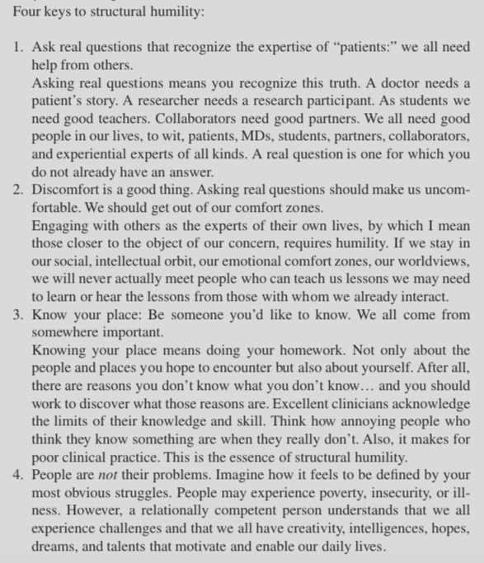

Slide 29
“Medical students often want to know what to do in these troubled times having gained a glimpse of insight from the readings. They ask, how can they be a clinician otherwise? I ask students to think of all the ways they currently take care of other people, at work, at school, at home. To think about the little ways, they already deeply listen and make a difference in the lives of those people; some they love, some they just happen to know, and some just because. ‘Make a list,’ I tell them. THIS is where you begin. Build upon these relational skills, these politics. Make these people and these relationships your teachers for facing and addressing this troubled world and these seemingly impossible problems. I tell them that they already have the seeds of what they need and are already making a world otherwise, one relationship at a time, whether they like it or not, understand it or not, and in this way they are making the world anew. This is what is needed for us to see what works, to learn from another, and to make a better world. My daily question is, am I ready to engage and thereby become otherwise? Are you?”
– Prof. Michael J. Montoya, UCI PRIME-LC

Slide 30
References
https://www.commonwealthfund.org/publications/fund-reports/2014/jun/mirror-mirror-wall-2014-update-how-us-health-care-system
https://www.visualcapitalist.com/u-s-healthcare-system-global-outlier-not-good-way/
https://www.pgpf.org/blog/2019/07/how-does-the-us-healthcare-system-compare-to-other-countries
https://www.apha.org/topics-and-issues/health-rankings
https://www.ncsl.org/Portals/1/HTML_LargeReports/HealthDisparity_1.htm
Metzl JM, Hansen H. Structural competency: theorizing a new medical engagement with stigma and inequality. Soc Sci Med. 2014 Feb;103:126-133. doi: 10.1016/j.socscimed.2013.06.032. Review. PubMed PMID: 24507917; PubMed Central PMCID: PMC4269606.
Metzl JM, Roberts DE. Structural competency meets structural racism: race, politics, and the structure of medical knowledge. Virtual Mentor. 2014 Sep 1;16(9):674-90. doi: 10.1001/virtualmentor.2014.16.09.spec1-1409. PubMed PMID: 25216304.
https://www.youtube.com/watch?v=7t-NbF77ceM
https://www.youtube.com/watch?v=1I2DvG_ocHg

Slide 32
Thank you for your attention!
@ryan_huerto
Visit melanininmedicine.org for additional content on health-equity.

